Slide 1



Data Analysis for
Social Buzz

Slide 2

Contents
Project Recap
Problem
The Analytics team
Conclusion & Summary
Process
Insights

Slide 3

Project Recap
Social Buzz~ a social media platform
Business ran by the company
Goals of the client

Slide 4


Problem
Scaling Process
IPO
Content Categories~ executed by
the data analytics team

Slide 5



The Analytics team

Slide 6
Process
1
Understanding the business problem
2
Collection of raw data
3
Cleaning, Structuring & Analysing
4
Visualization of Data
5
Conclusion, Insights & Summary

Slide 7
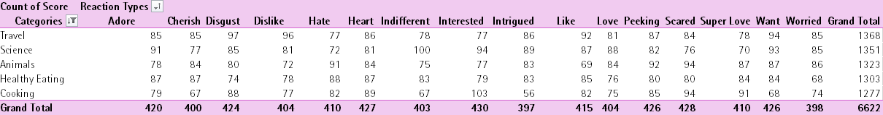
Modelled Data
Top 5 Categories with
“Pleasant & Unpleasant” Reactions
Real Time Data

Slide 8
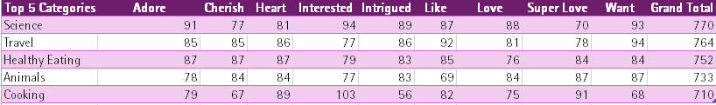
Modelled Data
Top 5 Categories with
“Pleasant” Reactions

Slide 9
Visualization of Data
Key Points:
SCIENCE with a total of 770 “pleasant” reactions.
Categories which are getting less pleasant reactions, needs to be reworked by the Social Media team for the content

Slide 10
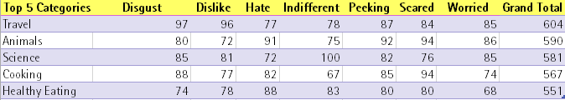
Modelled Data
Top 5 Categories with
“Unpleasant” Reactions

Slide 11
Visualization of Data
Key Points:
TRAVEL with a total of 604 “unpleasant” reactions.
Unpleasant user’s reactions could be due to irrelevant content showing up under the given categories

Slide 12
Conclusion
Populate & try new content under the categories getting more “pleasant” reactions.
Tweaking, Improving & Monitoring the posts gaining “unpleasant” user reactions.
Analysing the user’s opinions on type of content they want!

Slide 13


Summary
Exploratory Data Analysis (EDA)
User centric platforms
Feedback & Opinions on type of Content and Categories

Slide 14
Thank you!
Notes:
Thank you very much for listening, please feel free to ask any questions that you may have!

